Slide 1
Introduction to Reflection

Slide 2

Presentation Topics
In this presentation, we will cover:
What is Reflection?
Working with the Reflection API
Advanced Reflection
© DevelopIntelligence http://www.DevelopIntelligence.com

Slide 3
Objectives
When we are done, you should be able to:
Define reflection
Describe how reflection is implemented in Java
Use reflection to perform dynamic discovery
Use reflection to perform dynamic invocation
Create a basic Java Reflection Example
© DevelopIntelligence http://www.DevelopIntelligence.com

Slide 4
What is Reflection?

Slide 5
What is Reflection? [part 1]
“Process by which a computer program can be modified in the process of execution”
Process typically referred to as reflective programming
© DevelopIntelligence http://www.DevelopIntelligence.com

Slide 6
What is Reflection? [part 2]
API - Provides run-time information discovery for classes, fields, methods, and constructors for objects loaded into the VM
Introduced in 1.1
Released in concert with JavaBeans and Remote Method Invocation
Updated to support new language features
Performance enhancements made in 1.4
© DevelopIntelligence http://www.DevelopIntelligence.com

Slide 7
Motivations for using Reflection
Delegate decisions to run-time instead of compile-time
  Instantiation of objects
  Discovery of object’s capabilities
  Modification of capabilities
Provides more decoupled source-code
© DevelopIntelligence http://www.DevelopIntelligence.com

Slide 8
Platform Support for Reflection
Fundamental support provided by JVM
Utilizes dynamic binding
  Known as dynamic class loading
  Provided through ClassLoaders
  “Translates” .class files into Class objects
Supported by two packages
  java.lang
  java.lang.reflect
© DevelopIntelligence http://www.DevelopIntelligence.com

Slide 9
Working with the Reflection API

Slide 10
Working with the Reflection API
Class object is the starting point
Accessed through Class literal
  Class clazz = Math.class;
  Abides by platform security rules
Multiple ways to get Class object
  Use dynamic class loading -
  Class clazz = Class.forName(“java.lang.String”);
  Get class from an object -
  String s = “Hello”;
  Class clazz = s.getClass();
Once Class object is located; can start dynamic discovery process
© DevelopIntelligence http://www.DevelopIntelligence.com

Slide 11
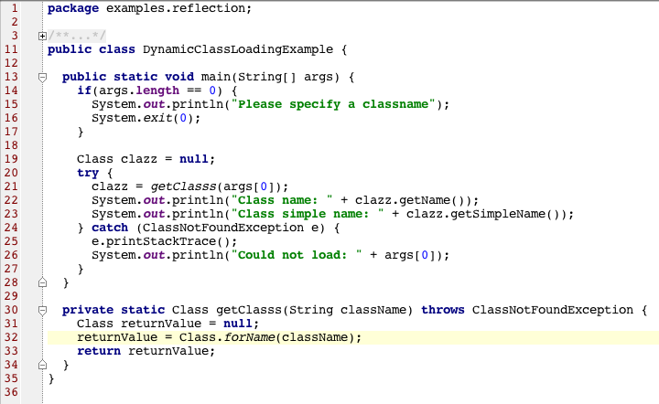
Dynamic Class loading Example
© DevelopIntelligence http://www.DevelopIntelligence.com

Slide 12
Discovery Class Type-Information
Can be used to find information about the class
  Package – supports further reflection
  Modifiers
  Name – simple or canonical
  Hierarchy – supports further reflection
    getSuperclass : Class
    getInterfaces : Class []
Can be used to find annotations
© DevelopIntelligence http://www.DevelopIntelligence.com

Slide 13
Discovery Class Contents
Can be used to find contents of class
  Field – named, public, or entire set
  Constructor – named, typed, public, or entire set
  Method – named and typed, public, or entire set
All contents are considered AccessibleObject
© DevelopIntelligence http://www.DevelopIntelligence.com

Slide 14
Further Discovery
Most discovered entities support further reflection
Primitives are handled in special way
  Denoted by wrapper class
  Can test to determine if field is primitive
Included support for
  Generics
  Enumerations
© DevelopIntelligence http://www.DevelopIntelligence.com

Slide 15
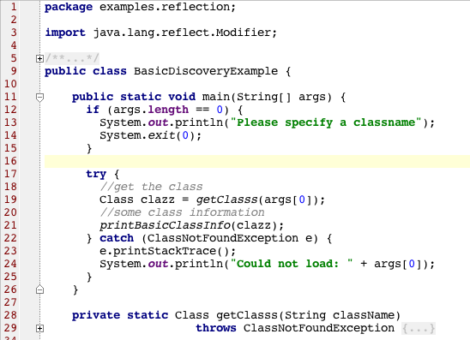
Basic Discovery Example
© DevelopIntelligence http://www.DevelopIntelligence.com

Slide 16
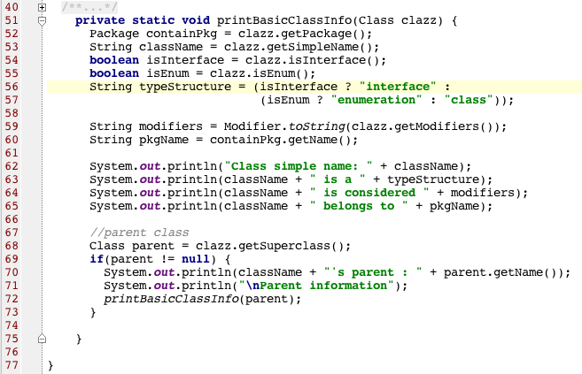
Basic Discovery Example [cont.]
© DevelopIntelligence http://www.DevelopIntelligence.com

Slide 17
Reflection Lab 1
Description: Use BasicDiscoveryExample as your starting point. Convert BasicDiscoveryExample into a replacement for the JDK command-line utility javap. javap provides a source-code like view of a class, showing class structure, fields, and methods. See instructions.txt for more details.
Duration: 30 minutes
© DevelopIntelligence http://www.DevelopIntelligence.com

Slide 18
Advanced Reflection

Slide 19
What is Reflection? [part 3]
API - Provides run-time invocation and modification on discovered fields, constructors, and methods
Reflection is not just about discovery; also about execution
© DevelopIntelligence http://www.DevelopIntelligence.com

Slide 20
Run-time Modification Using Reflection
Class object is still starting point
Dynamically discover fields, constructors, or methods
Perform appropriate invocation
© DevelopIntelligence http://www.DevelopIntelligence.com

Slide 21
Instantiation Using Reflection
May need to convert Class object into Object object
Two reflection based mechanisms
  newInstance method on every Class object
    Functions like new operator
    Relies on public no-argument constructor
  newInstance method on Constructor object
    Discover Constructor from class
    Functions like new operator
    Relies on argument list associated with specific Constructor object
Be sure to handle exceptions
© DevelopIntelligence http://www.DevelopIntelligence.com

Slide 22
Field Modification Using Reflection
Field modification requires an object instance
  Could be Class object (static)
  Or an Object object (instance)
Object can be result of run-time instantiation, but not required
  Discover Field from Class
  Get / set Field using Field, Object instance, and field value
    public void set(Object instance, Object value)
    public Object get(Object instance)
    public void setInt(Object instance, int value)
    public int getInt(Object instance)
© DevelopIntelligence http://www.DevelopIntelligence.com

Slide 23
Method Invocation Using Reflection
Method invocation requires an object instance
  Could be Class object (static method)
  Or an Object object (instance method)
Object can be result of run-time instantiation
  Discover method from Class
  Invoke method using Method, Object instance, and method args
public Object invoke(Object instance, Object… args)
© DevelopIntelligence http://www.DevelopIntelligence.com

Slide 24
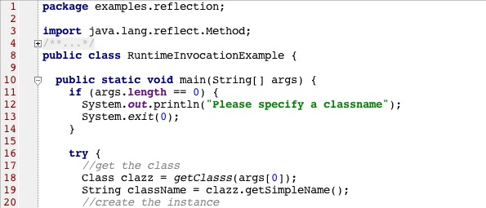
Run-time Example
© DevelopIntelligence http://www.DevelopIntelligence.com

Slide 25
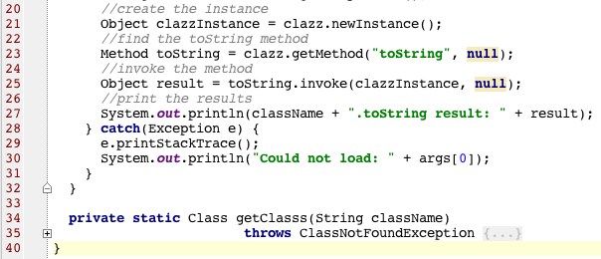
Run-time Example [cont.]
© DevelopIntelligence http://www.DevelopIntelligence.com

Slide 26
New Features in Reflection
1.3 – Dynamic proxy support
  Useful for “wrapping” an implementation
  Implementation invocation requests go through InvocationHandler
1.4 – Performance improvements
1.5 – Support for new language features
© DevelopIntelligence http://www.DevelopIntelligence.com

Slide 27
Reflection best-practices
At one point, goal was to use sparingly
Things have changed
  Significant performance improvements have helped
Consider using Reflection to implement design patterns
Make sure Security Manager is configured to support reflection
© DevelopIntelligence http://www.DevelopIntelligence.com

Slide 28
Reflection Lab 2
Description: Use RuntimeInvocationExample as a starting point.The current RunTimeInvocationExample uses the newInstance method to create an instance of a class. In certain cases, this is fine. However, most classes have constructors that take arguments for their object initialization. Expand RuntimeInvocationExample to support constructor-based object instantiation for the primitive wrapper classes and String. See instructions.txt for more information.
Duration: 30 minutes
© DevelopIntelligence http://www.DevelopIntelligence.com

Slide 29
Summary
Reflection is not a new API
It is a powerful run-time object interrogation facility
It supports run-time object execution mechanism
© DevelopIntelligence http://www.DevelopIntelligence.com

Slide 30
Reflection Lab [Optional]
Description: Create a basic unit-test framework using the Reflection API. The unit-test framework, UnitTester should dynamically load a class passed as a command line argument. Once the class is loaded, the UnitTester should inquirer the class for its test methods. All test methods should begin with the word test and should not take any arguments. They should return either a true or false. Test methods can generate exceptions if need be. The UnitTester should test static methods first and then proceed to instance methods. The UnitTester should keep track of the methods that passed (true), failed (false), or error (exception). Once all the methods have been tested, the UnitTester should generate a test report.
Duration: 30 minutes.
© DevelopIntelligence http://www.DevelopIntelligence.com

